Slide 1

TOPIC- Introduction to computer
COURSE: CCC Concepts
CHAPTER: 01 (Introduction to computer)
DAY: 01
NIELIT
Presentation By : Shruti Dubey

Slide 2
Introduction to computer
A computer is an electronic device, operating under the control of instructions stored in its own memory that can accept data (input), process the data according to specified rules, produce information (output), and store the information for future uses. Any kind of computers consists of HARDWARE AND SOFTWARE.
एक कंप्यूटर एक इलेक्ट्रॉनिक उपकरण है, जो अपनी स्मृति में संग्रहीत निर्देशों के नियंत्रण में काम कर रहा है जो डेटा (इनपुट) को स्वीकार कर सकता है, निर्दिष्ट नियमों के अनुसार डेटा को संसाधित कर सकता है, जानकारी (आउटपुट) का उत्पादन कर सकता है, और भविष्य के उपयोगों के लिए जानकारी संग्रहीत कर सकता है। किसी भी प्रकार के कंप्यूटर में हार्डवेयर और सॉफ़्टवेयर होते हैं।

Slide 3
Characteristics of Computer
The essential characteristics of the computer make it such an important part of human lives. Let's understand the basic characteristics of computers:
Speed: Computers are a high-speed electronic machine. They can carry around 3-4 million instruction per second. Even advanced computers can handle trillions of instructions per second, cutting down the time to perform any digital tasks.
Accuracy: Computers are also known for their accurate performance. They can complete the given jobs at almost 100% accuracy. Although errors may occur in computers, they are usually caused by incorrect input, incorrect instructions, or bugs in chips. All of these are human errors.
Storage Capacity: Computers can easily store a massive size of data. Modern computers come inbuilt with high storage features compared to older days. Additional data can be stored on secondary devices like external hard disks, or flash memory, etc. Due to incredible speed, data can be retrieved from storage in no time.
Reliability: Computers are reliable and consistent; they can process the same tasks any number of times without throwing any error. Computers don'st get tired like humans, so they are superior to perform rule-based, repetitive tasks.
Versatility: The variety of tasks that a computer can perform are almost infinite. That means computers can perform different tasks back to back without making errors; they are no longer just a computing machine. For one moment, a
computer can be used to perform data entry tasks or ticket booking, and the very next moment, it can be used for complex mathematical calculations or continuous astronomical observations, etc.

Slide 4
Latest IT Gadgets
A gadget is a small tool or device that has a specific useful purpose and function Gadget tend to be more unusual or cleverly designed then normal technology. A gadget make our life comfortable and also saves our time and money.
Smart Watch
Google Glass
Drone Camera
Pen with Camera
Robot vacuum cleaners
Wireless speakers
Clocky robotic alarm
Solar-powered path light

Slide 5
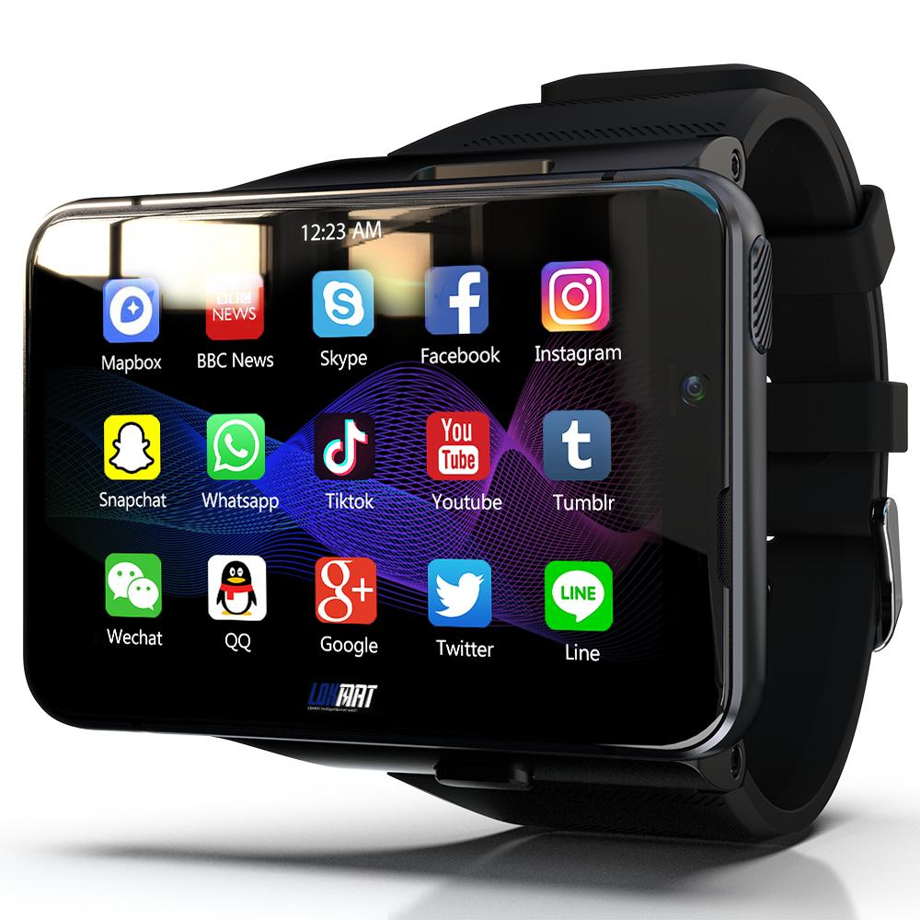
Smart Watch
A smart watch is a wearable computer in the form of a watch; modern smart watches provide a local touchscreen interface for daily use, while an associated smartphone app provides for management and telemetry.

Slide 6
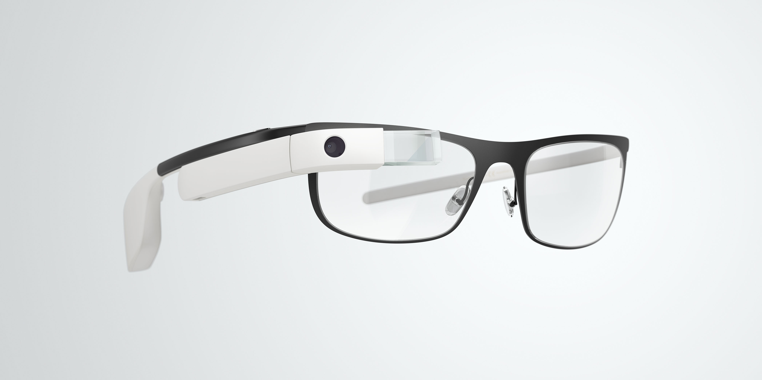
Google Glass
Google Glass is a wearable, voice- and motion-controlled Android device that resembles a pair of eyeglasses and displays information directly in the user's field of vision. Google Glass offers an augmented reality experience by using visual, audio and location-based inputs to provide relevant information

Slide 7
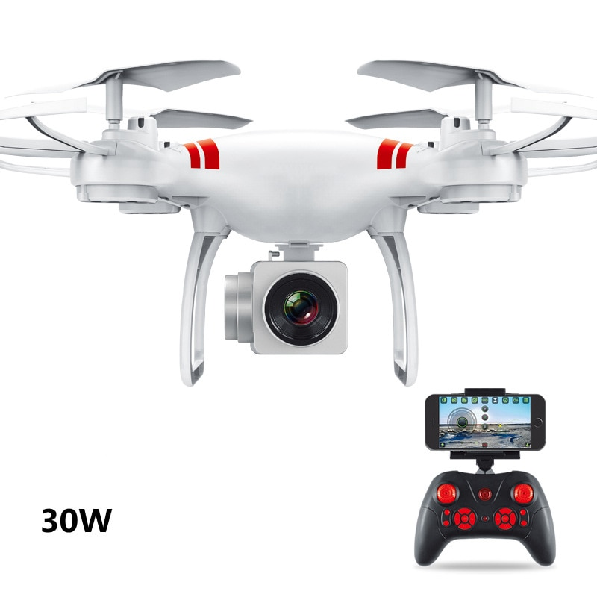
Drone Camera
Drone cameras are just regular cameras, only smaller, that are designed to work on a drone. Most of the work drones carry out include taking photographs, recording videos, and carrying various payloads necessary to the work at hand. All you need to do is select a camera drone that suits your needs

Slide 8
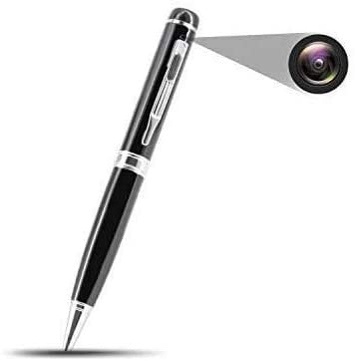
Pen with Camera
Simply put, a spy pen is an ordinary pen. Still, an ideal one with a hidden digital camera concealed inside allows the user to take a covert video, often with the pen placed in a shirt pocket or held in hand. It's the best pen camera that can be taken anywhere because of its portability, mainly for spy purposes

Slide 9
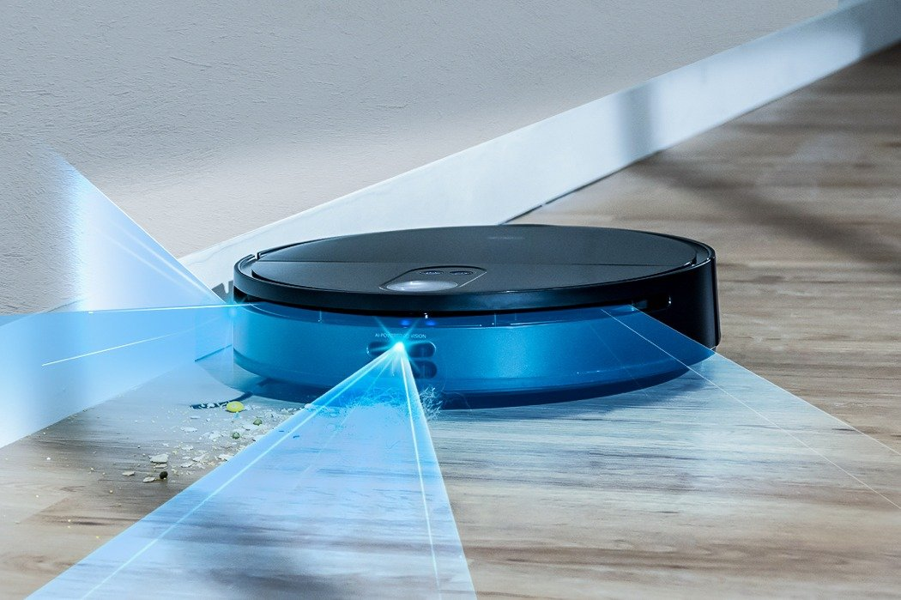
Robotic vacuum cleaner
A robotic vacuum cleaner, sometimes called a robovac or a Roomba as a generic trademark, is an autonomous robotic vacuum cleaner which has a limited vacuum floor cleaning system combined with sensors and robotic drives with programmable controllers and cleaning routines

Slide 10
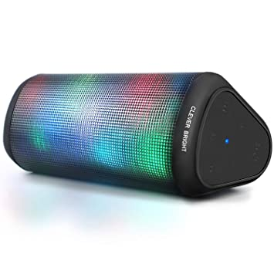
Wireless speakers
Wireless speakers are loudspeakers that receive audio signals using radio frequency waves rather than over audio cables. A transmitter connected to the stereo system converts electrical signals to radio waves by sending alternating current through an antenna. The radio waves broadcast out from the antenna. An antenna and receiver on the wireless speaker detect the radio signal, and the receiver converts it into an electrical signal

Slide 11
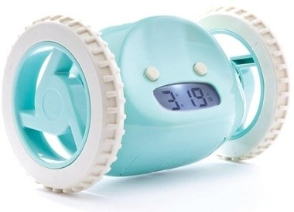
Clocky robotic alarm
Have you felt the need for an alarm that can outsmart and wake you instantaneously? Clocky will make you run around the room before you can turn it off. This smart alarm clock runs away and hides as it continues to beep until you get off your bed. You can no longer snooze and go back to bed. Clocky will ensure you never oversleep again

Slide 12
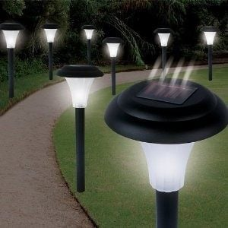
Solar-powered path light
Solar-powered LED path lights are an ideal eco-solution for your garden. They are powered by solar energy and do not require any wiring or electricity. You can conserve energy and save money on your electricity bills with this smart technology that uses solar energy to illuminate your garden. These lights automatically turn on at dusk and off at dawn. You will never have to worry about a dark garden or a patio when you are away from home by installing these energy efficient lights

Slide 13
History of Computer
The term 'Computer' was first introduced in 1640 and referred to as 'one who calculates'. It was derived from the Latin word 'computare', which meant 'to calculate'. In 1897, it was known as the 'calculating machine'. Later in 1945, the term 'computer' was introduced as 'programmable digital electronic computer, which is now called a 'computer'.
When the computers were introduced, they were large and could fill an entire room. Some computers were operated using large-sized vacuum tubes. In 1833, Charles Babbage (known as the father of the computer) invented an early calculator, which was named as the 'difference engine'. Later in 1837, he introduced the first mechanical, general-purpose computer 'Analytical Engine'. Over time, computers became powerful in performance and small in size.
The first counting device was used by the primitive people. They used sticks, stones and bones ass counting tools. As human mind and technology improved with time more computing devices were developed. Some of the popular computing devices starting with the first to recent ones are described below;

Slide 14
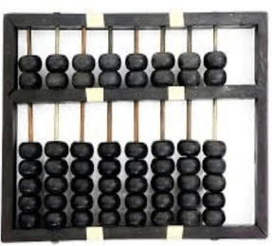
First computer Abacus
The history of computer begins with the birth of abacus which is believed to be the first computer. It is said that Chinese invented Abacus around 4,000 years ago.
It was a wooden rack which has metal rods with beads mounted on them. The beads were moved by the abacus operator according to some rules to perform arithmetic calculations. Abacus is still used in some countries like China, Russia and Japan. An image of this tool is shown below;

Slide 15
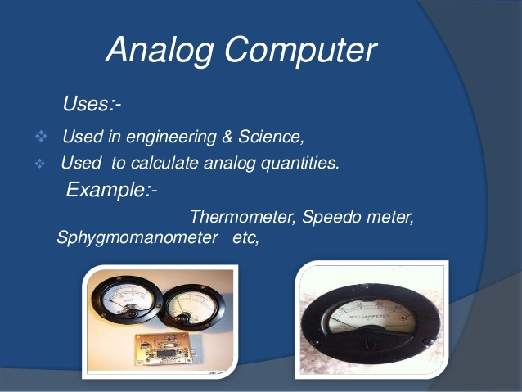
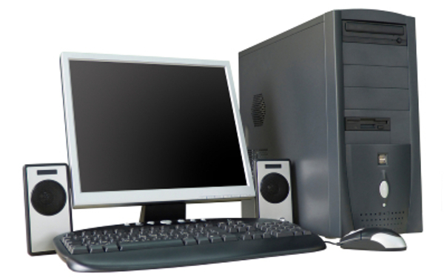
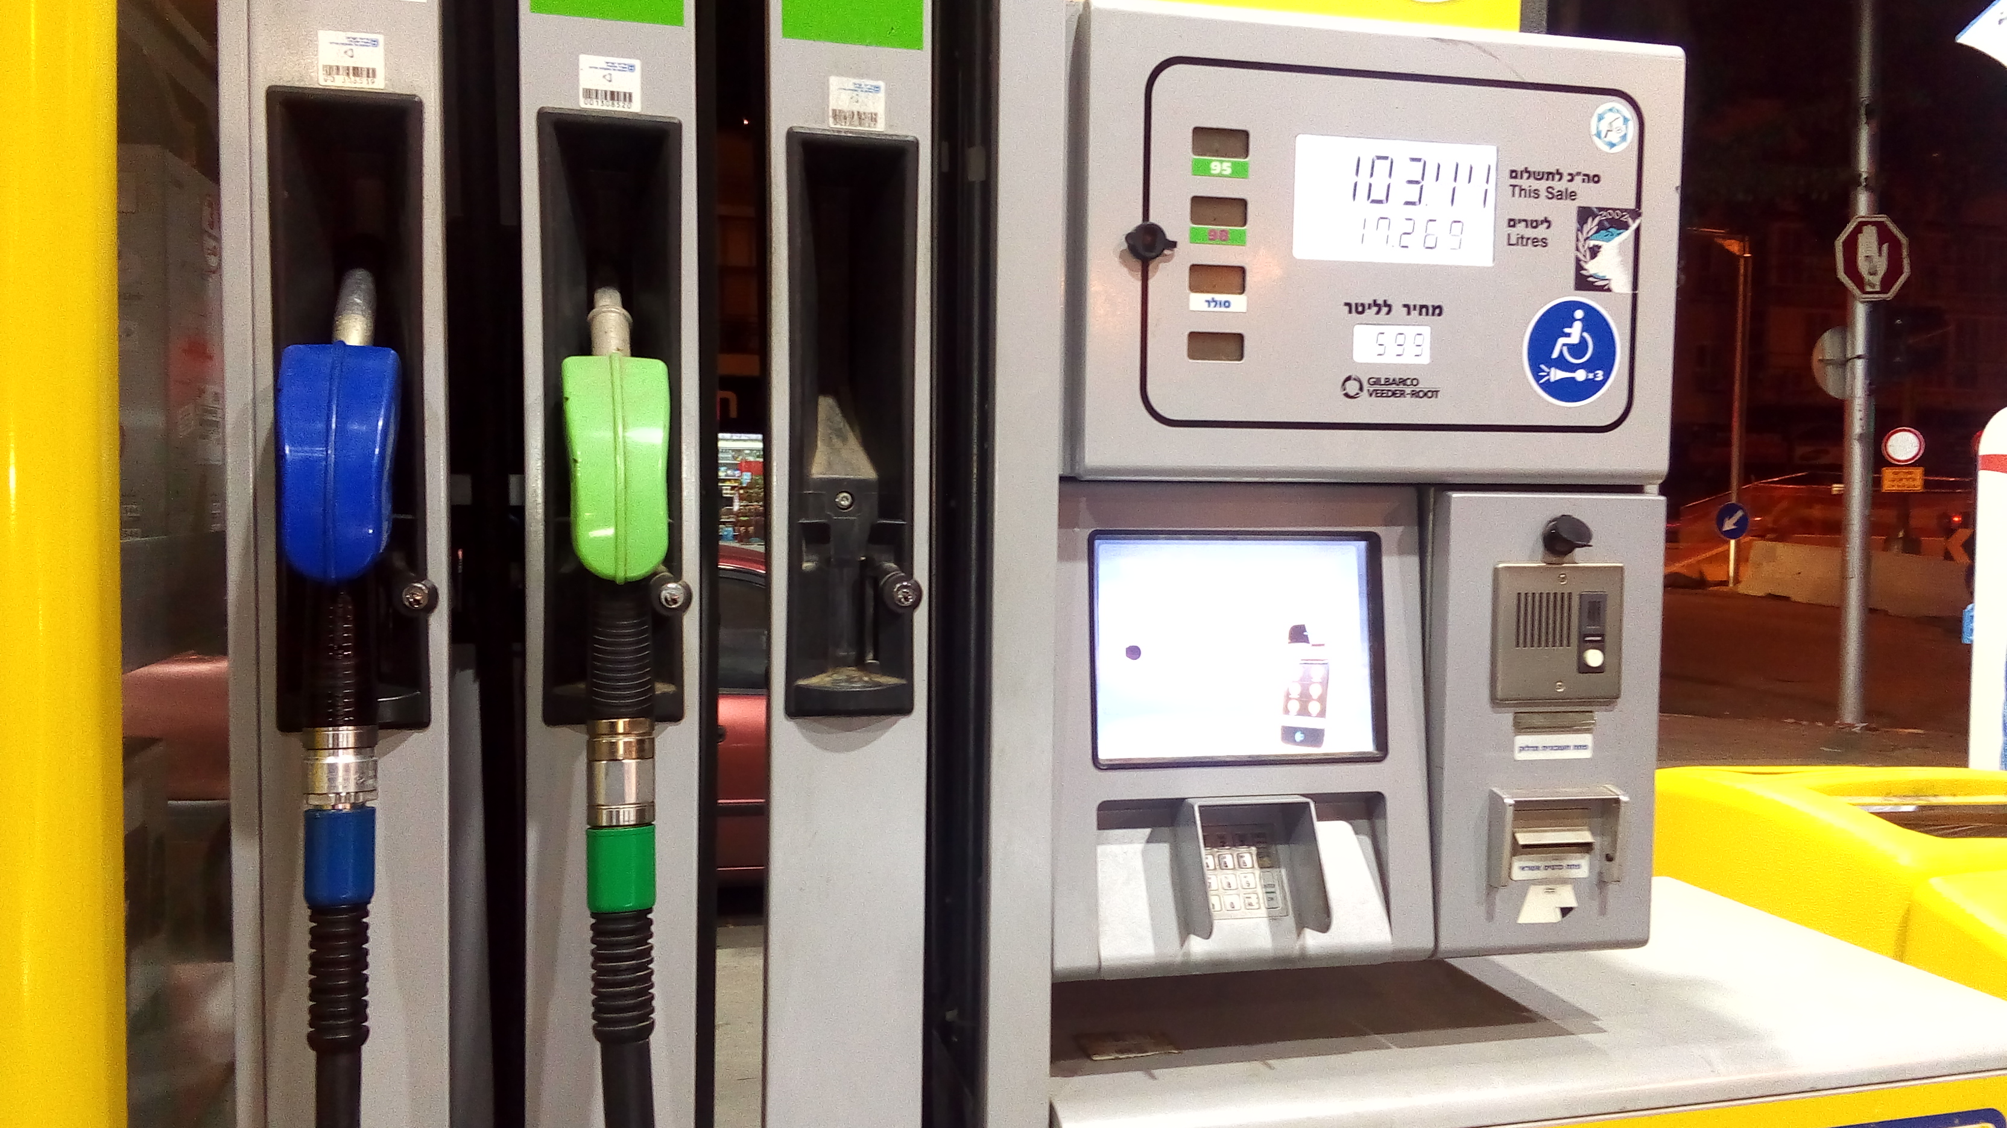
Types of Computer
1. Analog Computer:
2. Digital Computer
3. Hybrid Computer
Digital Computer

Slide 16
Analogue computers
Analogue computers are designed to process analogue data. Analogue data is continuous data that changes continuously and cannot have discrete values. We can say that analogue computers are used where we don't need exact values always such as speed, temperature, pressure and current.
Analogue computers directly accept the data from the measuring device without first converting it into numbers and codes. They measure the continuous changes in physical quantity and generally render output as a reading on a dial or scale. Speedometer and mercury thermometer are examples of analogue computers.

Slide 17
Digital computers
Digital computer is designed to perform calculations and logical operations at high speed. It accepts the raw data as input in the form of digits or binary numbers (0 and 1) and processes it with programs stored in its memory to produce the output. All modern computers like laptops, desktops including smartphones that we use at home or office are digital computers.

Slide 18
Hybrid computer
Hybrid computer has features of both analogue and digital computer. It is fast like an analogue computer and has memory and accuracy like digital computers. It can process both continuous and discrete data. It accepts analogue signals and convert them into digital form before processing. So, it is widely used in specialized applications where both analogue and digital data is processed. For example, a processor is used in petrol pumps that converts the measurements of fuel flow into quantity and price. Similarly, they are used in airplanes, hospitals, and scientific applications.

Slide 19
Thank You
NIELIT
Presentation By : Shruti Dubey

